Slide 1

TARGET FOLDER
SRNTGT108
Air Defence Command Centre, SRN
OPAC CLASSIFIED
REL TO CJTF-23
OPAC CLASSIFIED
REL TO CJTF-23

Slide 2


Air Defence Command Centre, SRN
OPAC CLASSIFIED REL TO CJTF-23
JOINT OPERATIONS GRAPHIC
MAP
OVERVIEW
BE: SRNTGT108 CATCODE: 11
MIDB GEO: N 68 55.713 E 033 10.092
ICOD: 2011-JUL-06 DOI:2011-JUL-06
DECL ON: 2061-JUL-06
N
Air defence Command Centre
SRNTGT108
.

Slide 3
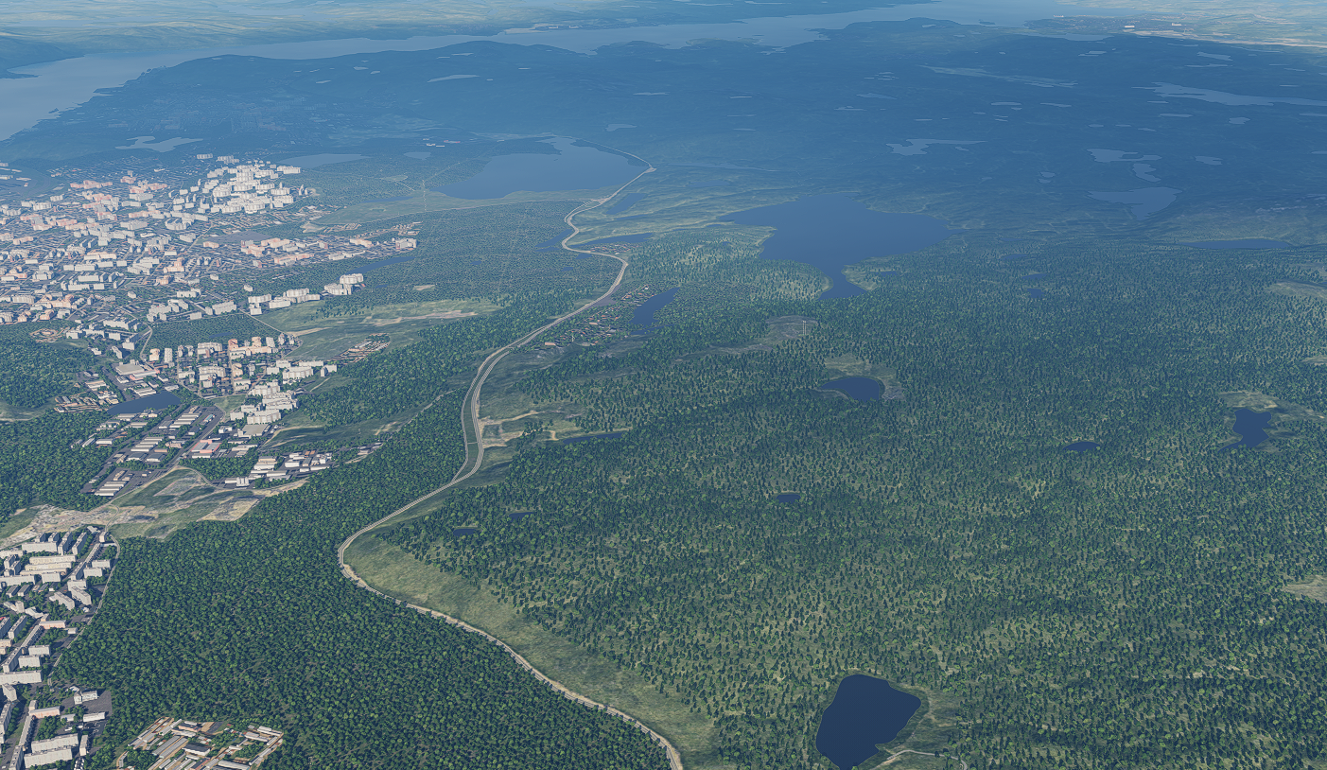
Air Defence Command Centre, SRN
OPAC CLASSIFIED REL TO CJTF-23
FACILITY OUTLINE GRAPHIC
MAP
OVERVIEW
BE: SRNTGT108 CATCODE: 11
MIDB GEO: N 68 55.713 E 033 10.092
ICOD: 2011-JUL-06 DOI:2011-JUL-06
DECL ON: 2061-JUL-06
N
Air Defence Command Centre
SRNTGT108

Slide 4
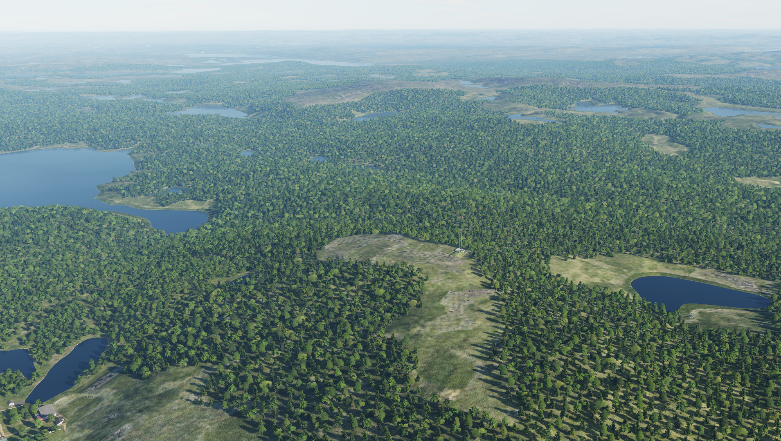
Air Defence Command Centre, SRN
OPAC CLASSIFIED REL TO CJTF-23
DESIRED POINT OF IMPACT GRAPHIC [X]
MAP
OVERVIEW
BE: SRNTGT108 CATCODE: 11
MIDB GEO: N 68 55.713 E 033 10.092
ICOD: 2011-JUL-06 DOI:2011-JUL-06
DECL ON: 2061-JUL-06
N
DPI: A
AIR DEFENCE COMMAND CENTRE N 68 55.713 E 033 10.092 DPI MSL: 967 FT

Slide 5
Air Defence Command Centre, SRN
OPAC CLASSIFIED REL TO CJTF-23
WEAPONEERING OPTIONS [X]
MAP
OVERVIEW
BE: SRNTGT108 CATCODE: 11
MIDB GEO: N 68 55.713 E 033 10.092
ICOD: 2011-JUL-06 DOI:2011-JUL-06
DECL ON: 2061-JUL-06
DPI | DESCRIPTION | TLE | WARHEAD | GUIDANCE | DESIRED EFFECT | IMPACT ANGLE | FUZING
A | AIR DEFENCE COMMAND BUNKER | CAT 1 | 2000 lbs PEN | METRIC | PENETRATION | 80-90 | 60ms
Notes:
TLE 1: 0-6m
TLE 2:7-15m
TLE 3:16-30m
TLE 4:31-91m
TLE 5:92-305
TLE 6: >305m
Warhead: 500Ibs, 1000Ibs, 2000Ibs
Guidance: N/A, Laserguided, INS/GPS

Slide 6
Air Defence Command Centre, SRN
OPAC CLASSIFIED REL TO CJTF-23
BATTLE DAMAGE ASSESSMENT GRAPHIC 1
MAP
OVERVIEW
BE: SRNTGT108 CATCODE: 11
MIDB GEO: N 68 55.713 E 033 10.092
ICOD: 2011-JUL-06 DOI:2011-JUL-06
DECL ON: 2061-JUL-06
POST-STRIKE
PRE-STRIKE
N
TARGET OBJECTIVE
DAMAGE/CHANGE ASSESSMENT
DPI:SRNTGT108
OPAC CLASSIFIED
REL TO CJTF-23
BDA REMARK: [CLASSIFICATION] [DISSEMINATION] Assessment: Physical Damage/change, Collateral Damage, Functional Damage/change, Munitions Effectiveness, Reattack Recommendation, Additional/Collateral Effects

Slide 7
BAKCUP SLIDES AFTER THIS

Slide 8

ACRONYMS
ACRONYM | MEANING | DEFINITION
BE | Basic Encyclopedia Number | Alpha/numeric code unique to an installation for incorporation within various national and tactical systems.
CATCODE | Category Code | The data Element that classifies the function and purpose of an installation or a facility.
MIDB | Modernized Integrated Database | A database comprised of information on facilities of military significance, military forces, and related equipment.
ICOD | Intelligence Cut Off Date | The date of the latest intelligence data inputted to a feature.
DOI | Date of Image | Date on which a geospatial or intelligence-related image was captured.
CE | Critical Element | An element of an entity or object that enables it to perform its primary function.
PV CHAR | Physical Vulnerability Characteristic | Standardized alphanumeric code describing the physical and structural properties of a target.
JDPI | Joint Desired Point of Impact | A unique, alphanumeric coded aimpoint identified by a three dimensional mensurated point. It represents a weapon or capability desired point of impact or penetration.
CE90 | Circular Error at 90% | 90 percent confidence level in the horizontal plane.
LE90 | Linear Error at 90% | 90 percent confidence level in the vertical dimension
MSL | Mean Sea Level | Elevation above Earth reference geoid.
AGL | Above Ground Level | Elevation above ground surface.
NCC | Nearest Collateral Concern | Closest non-targeted structure, area, or entity near a planned point of impact that may be at risk of unintended damage during a military strike.
CER | Collateral effects radius | Radius within which collateral damage might happen based on the weapon's characteristics, the target environment, and other operational factors.
CDE | Collateral damage estimate | Systematic process used in military targeting to evaluate the potential for unintended damage or harm to non-combatant entities, structures, or personnel as a result of a planned strike.
NSE | No Strike Element | Specific entities, locations, or objects that are protected from intentional targeting under the Law of Armed Conflict (LOAC) or by operational policy.

Slide 9
TARGET CATEGORIES
TARGET CATEGORIES
CATEGORIES | TYPE
1 | Weapons of Mass destruction (Nuclear, Biological, Chemical)
2 | Command, Control and Communications
3 | Airforces and airfields
4 | Air Defence
5 | Ground forces and facilities
6 | Naval forces and ports
7 | Petroleum industry
8 | Electric power
9 | Military production, supply and storage (Military industry)
10 | Transportation / lines of communications
11 | Political leadership
12 | Media
13 | Industry (Civilian)
14 | Infrastructure

Slide 10
DESIRED EFFECTS
Definition: destructive effects available upon detonation of a weapon.
KILL EFFECT |  | DEFINITION
BLAST |  | The high-pressure shockwave created by an explosion, traveling outward from the detonation point. Blast effects cause destruction by overpressure (compression force) and dynamic pressure (wind generated by the expanding gases), which can demolish structures, damage equipment, and injure personnel.
FRAGMENTATION |  | The dispersal of shrapnel or debris from an exploding munition. Fragments are propelled outward at high velocity, targeting personnel, equipment, and light structures in the area of effect.
PENETRATION |  | The effect of a munition or projectile piercing a target's surface without fully passing through it. Penetration is often used to defeat hardened targets, such as bunkers, by transferring energy into the target's structural layers.
INCENDIARY |  | The combustion of materials caused by incendiary munitions, secondary explosions, or the heat from a blast. Fire destroys flammable materials and can cause secondary damage to structures and equipment, as well as injuries to personnel.
CRATERING |  | The formation of a crater in the ground caused by the impact or detonation of a munition. Cratering disrupts mobility and operations, damaging roads, runways, or creating obstacles in the battlefield.
PERFORATION |  | The complete passage of a munition or projectile through a target, creating both an entry and exit point. Perforation may reduce the energy transfer to the target, making it less effective for destroying heavily armored or reinforced structures.
EARTH SHOCK |  | The seismic-like vibrations transmitted through the ground from an explosion. Earth shock can damage underground structures, destabilize foundations, or incapacitate personnel in subterranean environments.
NUCLEAR RADIATION |  | The release of ionizing radiation (alpha, beta, gamma, and neutron particles) from a nuclear explosion. Nuclear radiation can cause immediate biological damage, long-term health effects, and contamination of the environment.
THERMAL RADIATION |  | The intense heat and light energy emitted by an explosion, especially in nuclear detonations. Thermal radiation causes burns, ignites materials, and can create secondary fires in the target area.

Slide 11
WEAPONEERING
Fuze delay.
0 ms = destroy the roof,
10 ms = explode 3 meters below roof, perfect for single storey building,
25 ms = good for all other buildings, explode inside the building.
60 ms for BLU-109 only, for bunkers or more than 20m high buildings.
For all bombs in level bombing, without specific input like impact angle on JDAMs, the higher you drop the bomb, the higher the impact angle. It goes from around 30° at 5000' to 60° at 250000. So basically you for the release profile by indicating the desired angle of impact

Slide 12
RISK ESTIMATE DISTANCES
Weapon | Description | 0,1 % PI
MK-82 | 500Ibs | 200
MK-83 | 1000Ibs | 250
MK-84 | 2000Ibs | 300
GBU-12 | 500Ibs, laserguided | 150
GBU-16 | 1000Ibs laserguided | 200
GBU-10 | 2000Ibs, laserguided | 250
GBU-24 | 2000Ibs, laserguided, PAweway III, BLU-109 | 250
GBU-38 | 500Ibs INS/GPS | 150
GBU-32 | 1000IbsINS/GPS | 200
GBU-31(V) 1/B | 2000Ibs, INS/GPS | 250
GBU-31 (V)3(B | 2000Ibs, INS/GPS BLU-109 | 250
CBU-87 |  | 300
CBU-97 |  | 300
CBU-103 |  | 300
CBU-105 |  | 300
MK20 Rockeye |  | 300
AGM-65 |  | 100
AGM-84
AGM-154A | Cluster | 300
AGM154C | 500Ibs, hardened targets | 200
2.75” Rockets |  | 100
APKWS rockets |  | 100
30mm gun |  | 75
20mm gun |  | 50
^{[1]} PI: Probability of incapacitation.Incapacitation means that a soldier that stands within this distance is physically unable to function in an assault within a 5-minute period after an attack. Ordnance delivery inside 0.1% PI distances will be considered as “danger close.”

Slide 13
COLLATERAL DAMAGE ESTIMATION
Collateral Effect Radius (CER) is based in Risk Estimates Distances.
CER is based on Risk Estimate Distances (listed in SPINS).
CDE 1: Military target (legal military target), no restriction
CDE 2: Structure within CER, but no collateral issue (storage, hut, small construction). No cluster munitions allowed and FAH need to take structure in minde to avoid damage.
CDE 3: Civilian structure within CER (Residential buildings, houses, structures that can cause secondary explosion, such as fuel storages), Precision guided munitons neededl
CDE 4: Civilian structure within CER and likely damaged by attack. Damages minimized by FAH and delayed fuze settings. JFACC approval agency for CDE 4 targets. (AWACS delegated during missions.
CDE 5: Civilian casualites expected, CJTF-HQ approval needed for striking CDE 5 targets.

